Slide 1





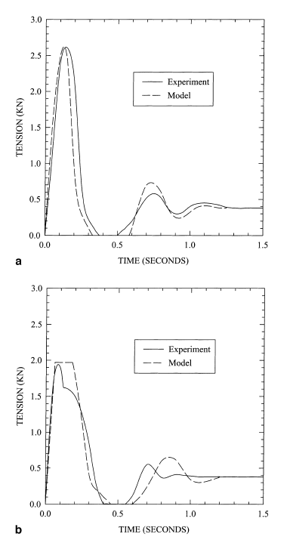
Simulation of Climbing Falls
Problem
Input Pitches and Simulation Results
When climbing outdoors, climbers use rope to keep them safe when taking a fall. However, the rope can take damage when breaking these falls, and if a climber isn’t careful, their rope can break. This creates a danger for the climber, thus I wish to simulate how much damage a rope could take from multiple falls before breaking, to create an estimate for a rope’s initial lifespan.
For all pitches, an initial strain offset of .05 was used to mimic the tension of the hanging rope, before the climber lands on it. The coefficient of friction used was 0.22, and the rope constants were set as follows: k1 = 35.0, k2 = 20.0, lambda = 3. Note that the last point in all graphs is the location of the climber before falling.
Trial 1
Theoretical Simulation
Trial 1 was meant to mimic the first test case in Pavier’s experiment, as a check to see the accuracy of my results.
Total rope length: 4.0 m
Weight used: 40 kg
My simulation yielded a maximum tension of 6.336 kN after 0.04 seconds. It reached a steady state around 1.3 seconds, with a resting tension of 0.392 kN. This maximum tension does not match with Pavier’s and thus means that there is some error in my implementation. The steady state, however, was reached at a similar time and the final resting tensions are the same.
First, the pitch is described as a set of 2d coordinates, where the belayer is placed at the origin. This shows that the leader has placed n-1 carabiners, breaking the rope into n segments. The leader then falls from some place, distance d above the last carabiner. From this, the length of each rope segment, the angle of lap, and thus the maximum tension ratios between each rope segment can be calculated with . Then, the strain in each segment is calculated using , where C relates the incremental slips to the incremental strains in each rope segment. Note a special case is used for slip at the last carabiner. For this, the velocity of the falling climber is taken into account, to create the appropriate amount of tension in the last segment. The incremental tensions in each segment can then be calculated from the strains using for k1, k2, and lambda being parameters of the rope.
This can be converted into a matrix equation of the form . Then, for each carabiner, rope slip can occur depending on the tensions on either side of the carabiner. A slip condition is positive if the tension on the left is greater than or equal to the tension on the right divided by the carabiner’s tension ratio. A slip is negative if the tension on the left is less than or equal to the tension on the right multiplied by the carabiner’s tension ratio. The relationship between these tensions is put into a matrix, L, such that it satisfies . We then combine previous equations to solve for incremental slips: . After incremental slips are found, the incremental strains can be found, and using that, the incremental tensions can be found. These incremental tensions are then added to the current tensions in each rope segment. This is used to get the new velocity of the falling climber.
Trial 2
Trial 2 mimics a small, more realistic, climbing pitch.
Total rope length: 11.5146 m
Weight used (round 1): 40 kg
Max tension: 5.751 kN after 0.05 seconds
Steady state tension: 0.392 kN
---
Weight used (round 2): 70 kg
Max tension: 6.654 kN after 0.06 seconds
Steady state tension: 0.686 kN
For Trial 2: Round 1, the maximum tension is increased as compared to the maximum tension in Trial 1. This makes sense due to the fact that the climber is falling a larger distance. The steady state tensions, however, are the same. This seems correct since the rope is the same in both trials, so the tension needed to suspend a 40 kg object should not change.
Comparing the two rounds, the maximum tension for the 70 kg object is higher than the maximum tension found for the 40 kg object, and the steady state tension needed to suspend the 70 kg object is higher than the steady state tension for the 40 kg object. This agrees with the intuition that a heavier object leads to higher tensions.
Pavier’s Results
The results of Pavier’s model can be seen in the charts to the left. The top chart shows a tied off belay where as the bottom chart shows the results of slip through the belay at a critical tension of 2kN.
The experiment the model is compared against uses the following set up: A mount is placed on vertical steel bars at some height. This mount is used to simulate a standard carabiner and is attached to strain gauges that record data throughout the experiment. A rope is threaded through the mount and a weighed trolley is attached to the other end of the rope.
Below is data Pavier collected from many experiments to create some relation between the tension in a rope and the potential falls it can take before breaking.
Belay Type | Mass (kg) | Fall Factor | Rope Length (m) | Falls to Failure | Max Tension (kN)
Tied | 60 | 0.86 | 2.50 | 15 | 5.7
Tied | 60 | 1.32 | 2.50 | 5 | 7.1
Tied | 60 | 1.77 | 2.50 | 4 | 8.2
Tied | 70 | 0.40 | 2.50 | 18 | 4.3
Tied | 70 | 0.80 | 2.50 | 10 | 5.9
Tied | 70 | 0.86 | 2.50 | 9 | 6.2
Tied | 80 | 0.86 | 2.50 | 7 | 6.6
Tied | 80 | 0.97 | 2.50 | 8 | 7.0
Tied | 80 | 1.77 | 2.50 | 3 | 9.4
Stitch Plate | 70 | 0.22 | 4.50 | 43 | 2.6
Stitch Plate | 70 | 0.22 | 4.50 | 27 | 4.0
Trial 3
Trial 3 mimics a bad climbing pitch – meaning, an example of what not to do when climbing. Specifically I tried to mimic “z-clipping” or clipping a carabiner with rope pulled from below the previously placed carabiner.
Total rope length: 10.478 m
Weight used: 40 kg
Max tension: 6.336 kN after 0.04 seconds
Steady state tension: 0.392 kN
The results of running this through my simulation are the same as running Trial 1. While this is disappointing, there are reasons why this test case may be troublesome. One is that climbing down and back up may have caused computational problems. Despite this, z-clipping is supposed to introduce high levels of friction into the system almost immediately so these are reasonable outputs for the maximum tension, assuming the simulation was accurate.
Tied belay means that there is no slip at the belay. The two different stitch plate results were derived from having different slip thresholds, created by using different grip pressures.

